Slide 1
NE555 SMD practice board

Slide 2
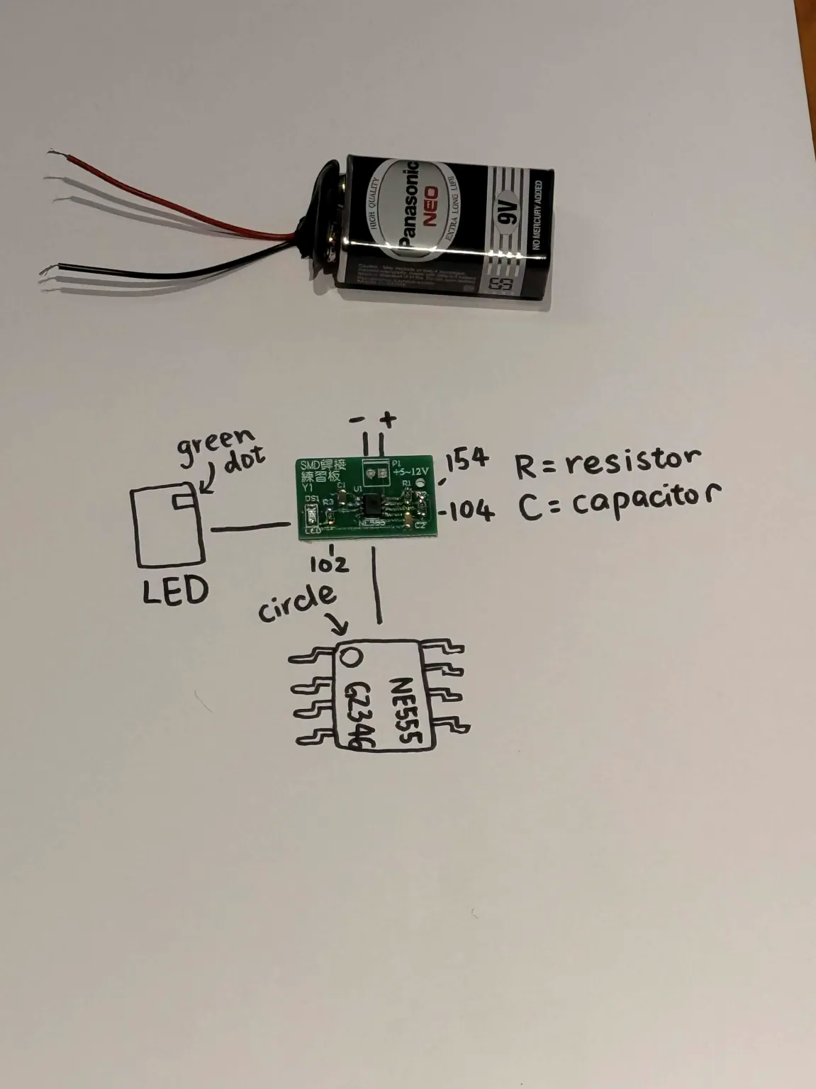

Slide 3
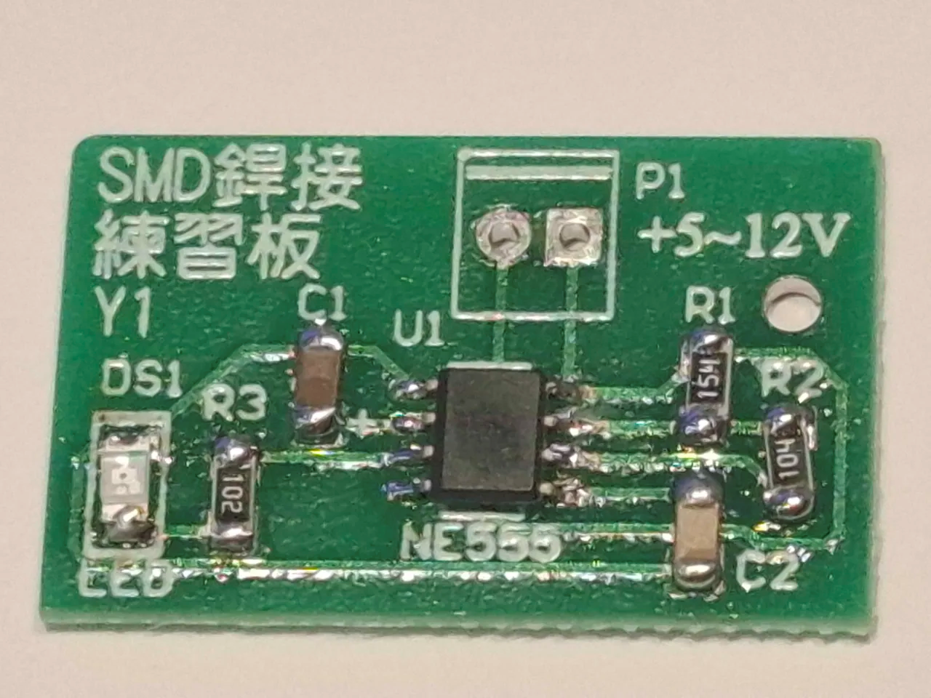

Slide 4
R1 : 154 (150KΩ)
R2 : 104 (100KΩ)
R3 : 102 (1KΩ)

Slide 5
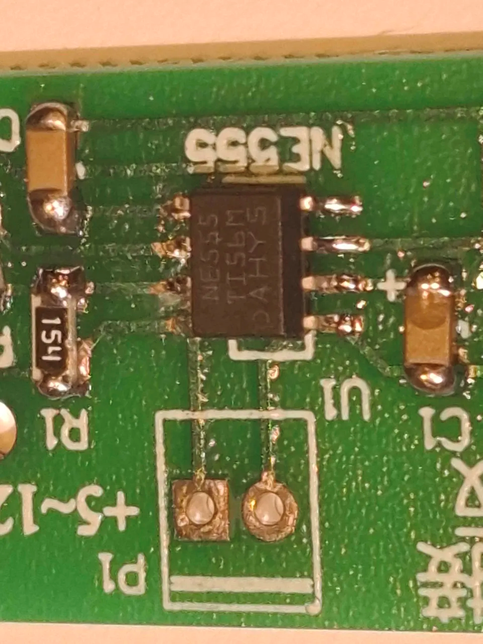
NE555 orientation:
Place the dot on the top left corner, and the text facing left

Slide 6
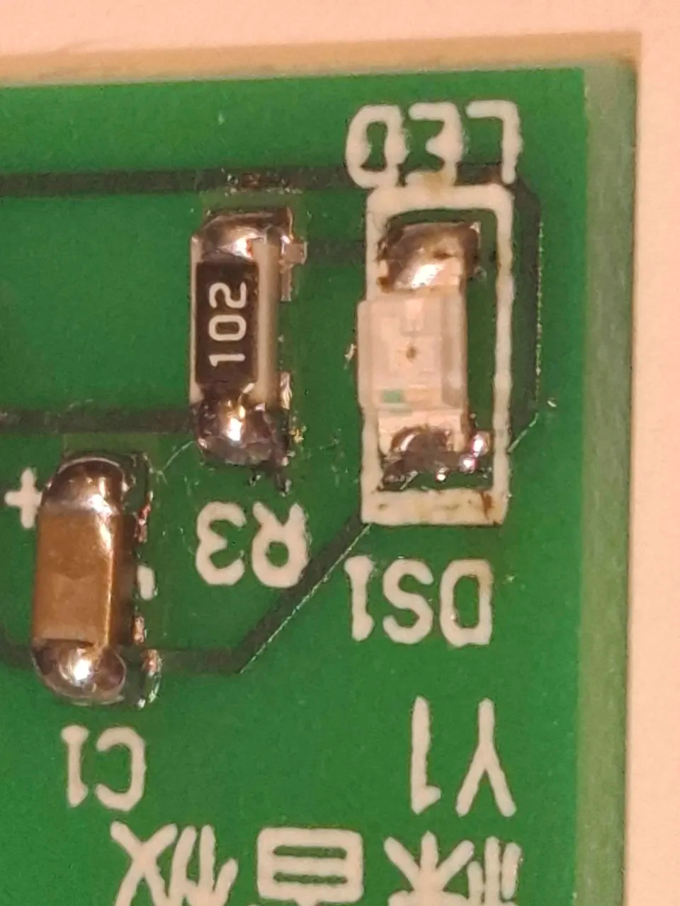
LED polarity:
The side with green dot is negative cathode, should be connected to the upper pad of the two

Slide 7
